Slide 1
A Deeper Investigation into the Predictors for Police Sentiment Scores
Using TreeInterpreter + other Methods
by Norman Lapid

Slide 2

Case File #ML2
Recap of Case File #ML1:
Used different ML regressors to identify predictors for trust scores in law enforcement
New Objective:
Apply interpretability methods to investigate a “black-box” Random Forest Model
ML2

Slide 3
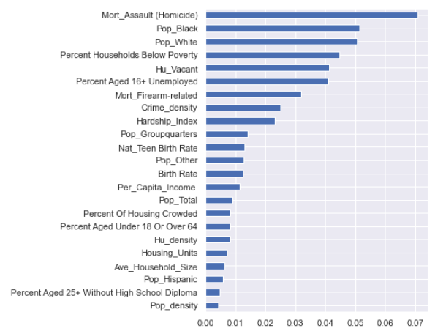
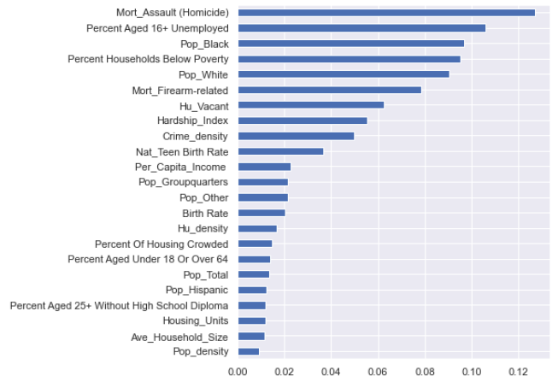
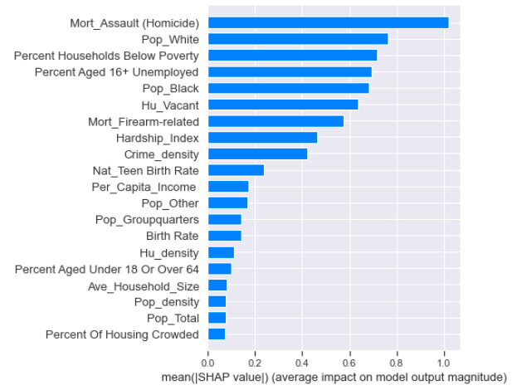
Permutation
Importance
manual implementation
or eli5 or sklearn
Feature
Importance
sklearn
Shap
Summary Plot
shap
Computed from accumulation of the impurity decrease within each tree
Permute features and compare accuracy against a baseline
Mean absolute SHAP values per feature across all samples

Slide 4
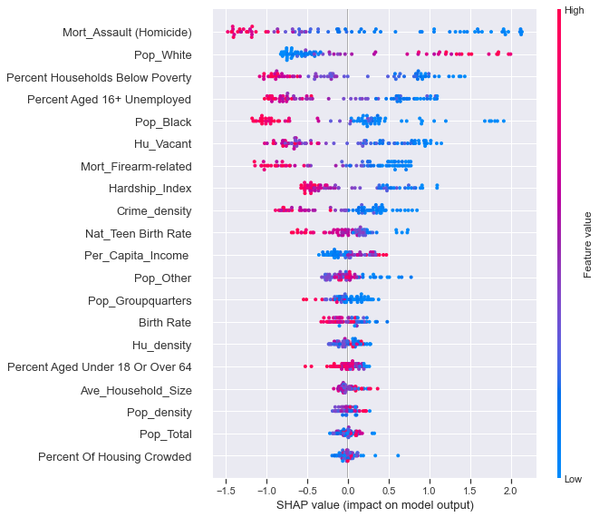
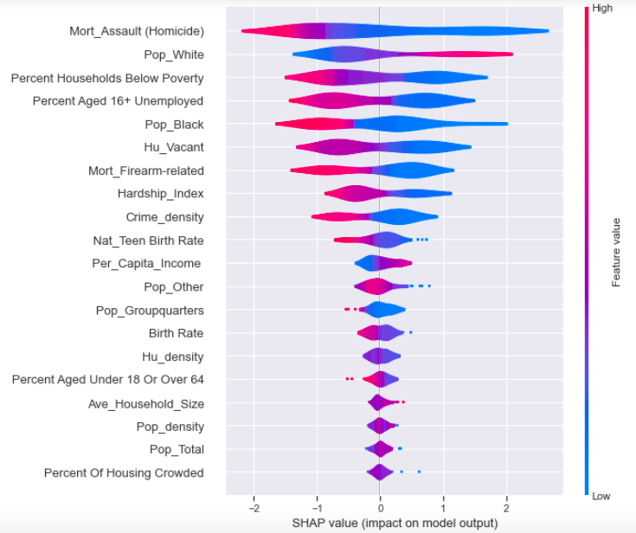
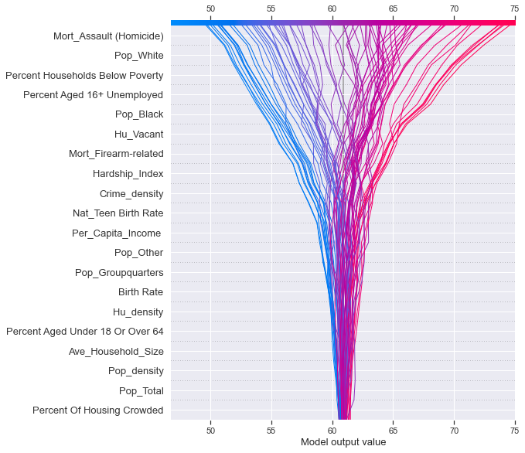
Beeswarm plot
Decision plot
Violin plot

Slide 5

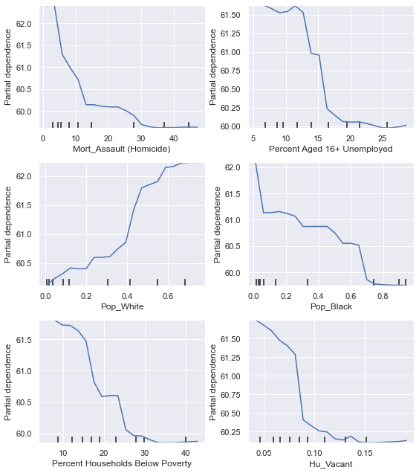
So far, all the evidence agrees:
Partial Dependence Plots (sklearn)
Trust in Police goes ↓ down in relation to:
Mortality from Homicides/Firearms
% Unemployed
% Black population
% Households below poverty
Vacant Housing Units
Trust in Police goes ↑ in relation to:
% White population

Slide 6
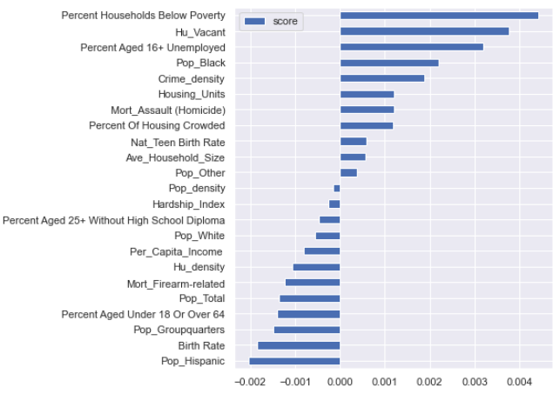




Drop Column Importance
manual implementation
Drop a feature and compare accuracy against a baseline
Top 5:
% Households below poverty
Vacant housing units
% Unemployed
% Black Population
Crime Density
Reduces accuracy:
% Hispanic population
Birth Rate
% Pop. In Group Quarters
% <18 or >64 in age
Total Population
Negative importance = removing these features improves accuracy!

Slide 7
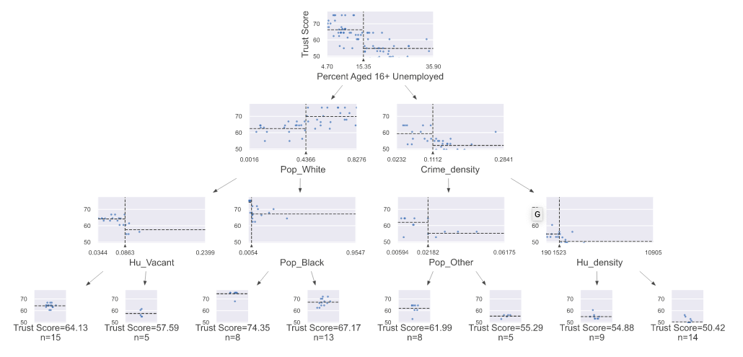
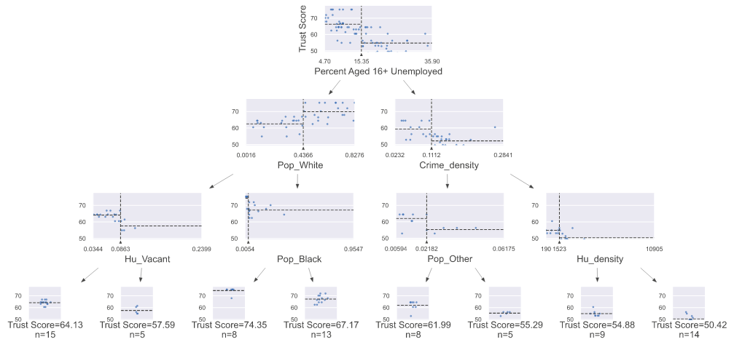
What about for Random Forests?
Ensemble of deep trees
× n_estimators

Slide 8
What about for Random Forests?
Ensemble of deep trees
Predictions are made by paths along trees (combinations of features)
Decomposing predictions by decomposing contributions of features will fail to consider feature interactions
× n_estimators

Slide 9
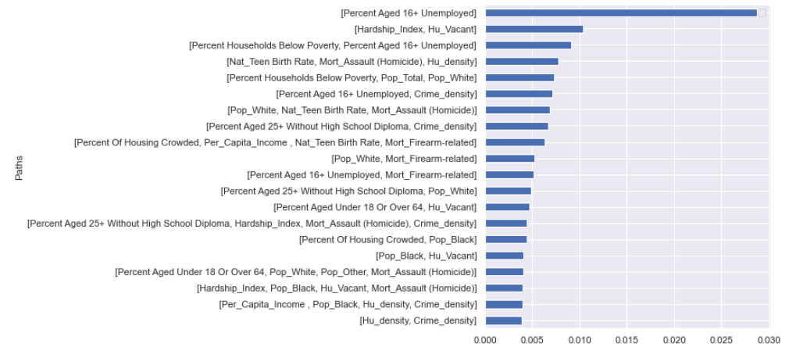
TreeInterpreter
Provides joint contributions, or contributions of the entire decision paths

Slide 10
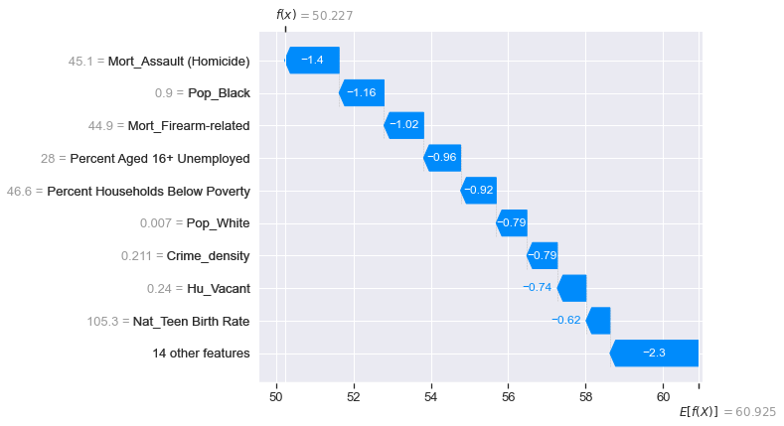
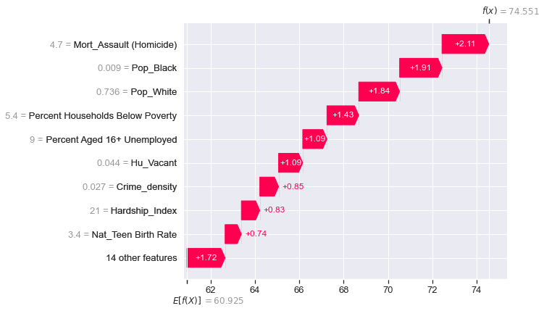
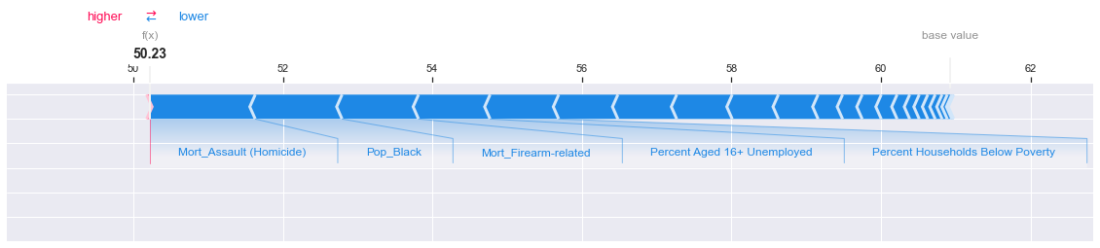
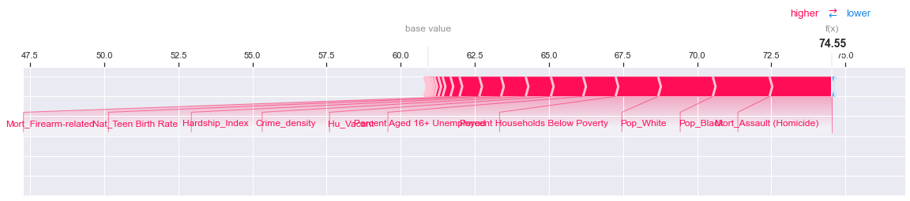
Local Interpretability Using SHAP
Waterfall plot

Slide 11






For a single tree, the prediction is the mean of the target variable (bias) plus the sum of contributions at each node
$$f\left(x\right)=c_{full}+\sum_{k=1}^{K}{contrib(x, k)}$$
Since the prediction of a forest is the average prediction for all trees:
$$F\left(x\right)=\frac{1}{J}\sum_{j=1}^{JK}{f_{j} (x)}$$
The prediction of a forest is the the average of the bias terms plus the average contribution of each feature
$$F\left(x\right)=\frac{1}{J}\sum_{j=1}^{J}{c_{j_{full}}}+\sum_{k=1}^{K}{\left(\frac{1}{J}\sum_{j=1}^{J}{{contrib}_{j}}(x, k)\right)}$$

Slide 12
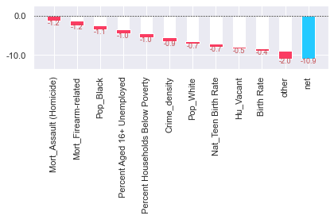
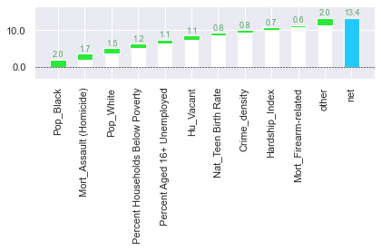
Local Interpretability Using TreeInterpreter
Waterfall plot

Slide 13

ML2
Thank you.

Slide 15
Case File #ML1
Objective:
Build a model to predict the degree to which police are trusted by members of their community.
Location: Chicago, IL, USA
ML1

Slide 16


Lay the groundwork. Investigation requires thorough research.
Case Learning #1:
Illinois Department of Public Health (IDPH)
Chicago
Metropolitan
Agency for
Planning
(CMAP)
Socio-
Economic
data
Demographic
data
Public
Health
indicators
U.S. Census Bureau
Crime reports
Chicago Police Department
Geographic data
Target variable:
Police
Sentiment Scores
Chicago
Police Department
&
Elucd
Wikipedia
Design Matrix

Slide 17


Case Learning #2:
LeaveOneOut:
R² → Error
Kfold(n_splits=10):
R² = -42%
Kfold(n_splits=6):
R² = 16%
RepeatedKFold
(n_splits=10, n_repeats=10):
R² = 62%
RepeatedKFold
(n_splits=6, n_repeats=10):
R² = 71%
✘
✘
Make the most of limited resources.
✘
✓
Reminder:
Check
Robust Scaling
vs
Standard Scaling
✓✓

Slide 18




Case Learning #3:
Follow proper procedure.
Construct a Pipeline
Apply transforms (scaling)
Apply an estimator (regression)
Define grid search parameters
Instantiate cross-validator
Apply GridSearchCV

Slide 19
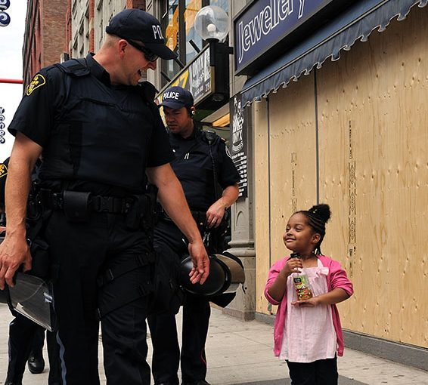

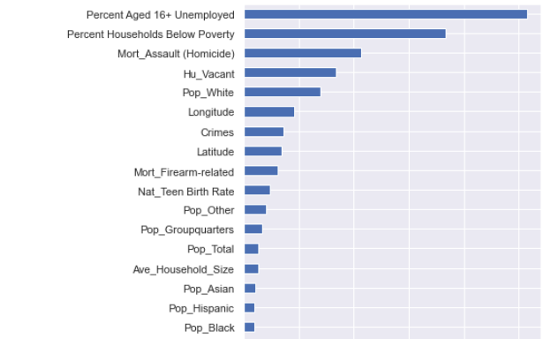
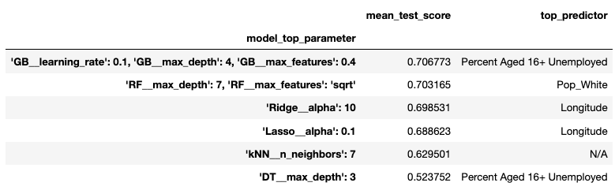
To build trust with the public, interpretability is key.
Case Learning #4:
Model: Gradient Boosting Method
✘

Slide 20

Top Suspects:
Unemployment
Race (% of white population)
Urban decay/Vacant housing
Per Capita Deaths from Homicide

Slide 21
ML1
Thank you.

